Slide 1
Enzymes
Dr Reshmy K.R
Professor
Dept.of Physiology
SKHMC

Slide 2
Enzymes
Biocatalysts which accelerate chemical reactions and plays a vital role in metabolism.
Consist of proteins with a molecular weight of about 10,000-100,000
The substances that are converted by enzymes are referred as substrates, the end result is the products.

Slide 3
Enzymes as Biocatalysts
Biocatalysts do not change the reaction pathway of a chemical reaction , but rather they accelerate the reaction by lowering the activation energy.
During the conversion of substrates to products , the enzyme is not consumed and exists unchanged after the reaction.
The reaction pathway can be represented simply as follows.
E + S ES E + P

Slide 4
Enzymes undergo an interaction with substrate known as Enzyme - Substrate complex .
The substrate -binding occurs at the active center of the enzyme.
The active center is a three -dimensional, specifically folded region , made of aminoacids and is usually arranged in a hollow shape.
The substrate -binding functions according to the Induced -fit model, which states that the active center changes its conformity after substrate binding in such a way that it is complementary to the substrate.

Slide 5
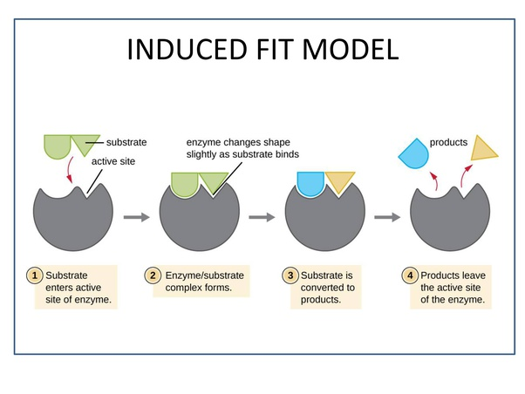
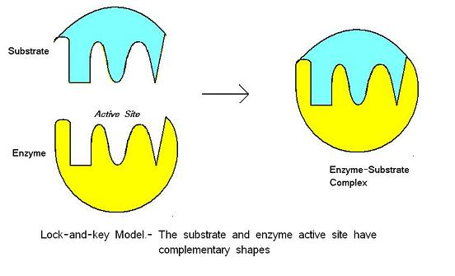
Induced fit model

Slide 6
Enzyme specificities
1. Substrate specificity
The induced -fit model forms the basis of the substrate specificity of enzymes - each enzyme can convert only one particular substrate.
eg: glucokinase of the liver converts only glucose into glucose -6- phosphate and no other hexoses.

Slide 7
2. Stereospecificity
eg; lactate dehydrogenase, can only convert L- Lactate to pyruvate and not its mirror image D-lactate
Lactate dehydrogense is sterospecific or optically specific

Slide 8
3. Group specificity
If an enzyme reacts with a specific chemical group aminogroup, that is located on the substrate , then the substrate itself is not relevant , but rather the chemical group that it carries.

Slide 9
4. Reaction specificity
The specificity of reaction states that each enzymes can catalyze only a specific type of reaction
The enzyme X catalyzes the reaction E + S ES E + P, but might not catalyze similar reaction E + S ES E + P1 + P2

Slide 10
Classification of enzymes
1.Oxidoreductases
dehydrogenases, reductases
2.Transferases
Aminotransferases( Asparte aminotransferases ASAT), Phpsphotrasferases ( glycogen phosphorylase)

Slide 11
3. Hydrolases
Esterases acetylcholinesterase, peptidases /Proteases
4. Lyases
aldolase, fumerase
5. Isomerases
cis- trans isomerases
6.Ligases
pyurvate ligases ,glutamine synthetase

Slide 12
Iso enzymes
Some enzymes catalyze the same reaction but differ slightly in their structure.
plays an important role in medicine since different isoenzymes are typical for specific organs and thus provide conclusions about pathologies.
valuable diagnostic parameter for the detection of diseases , when a certain isoenzyme is increased inthe blood.
eg; CK Creatine kinase - localized in heart muscle

Slide 13
Coenzymes
Enzymes are often dependent on auxiliary molecules, so called coenxymes without which a reaction might not be catalyzed.
These helpers can be firmly bound to the enzyme - prosthetic group.
Can exist in soluble form.
Purpose is to support taking over, eg; the transfer of electrons.
NAD⁺/NADP⁺
FAD
Cytochrome
Biotin
Coenzyme A

Slide 14
Kinetics of enzymes
The sequences of enxymes - catalyzed reactions with the dependence on various parametres.
Dependence of the reation rate on temperature.
The reaction rate doubles for every 10 degree increase in temp.
The dependence of the reaction rate on pH value.
Enzymes have a optimum pH and changes in the pH value cause functional group of enzymes itself or of its substrate to change - leads to changes in the spatial structure so that bond at the active center is improved or deteriorated.
Denaturation of enzymes at stronger pH & at too high temperature.
Eg pepsin acts at a pH of 2

Slide 15
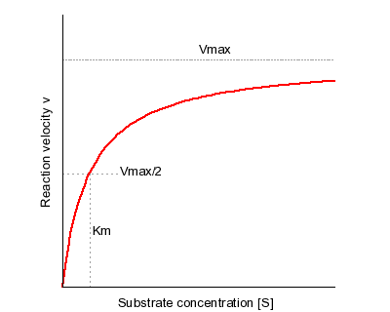
Michaelis-Menten model- Dependence of the reaction rate on substrate conc.
One of the simplest and best-known approaches to enzyme kinetics.
KM - Michaelis constant is the substrate concentration at which the reaction velocity is 50% of the Vmax.
[S] is the concentration of the substrate S.

Slide 16
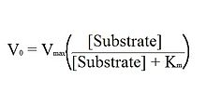
Michaelis-Menten model
Km is the Michaelis-Menten constant which shows the concentration of the substrate when the reaction velocity is equal to one half of the maximal velocity for the reaction.
It can also be thought of as a measure of how well a substrate complexes with a given enzyme, otherwise known as its binding affinity.
An equation with a low Km value indicates a large binding affinity, as the reaction will approach Vmax more rapidly.
An equation with a high Km indicates that the enzyme does not bind as efficiently with the substrate, and Vmax will only be reached if the substrate concentration is high enough to saturate the enzyme.
V0 is the initial velocity of the reaction.
Vmax is the maximal rate of the reaction.
[Substrate] is the concentration of the substrate.

Slide 17
The Michaelis-Menten equation arises from the general equation for an enzymatic reaction-: E + S ↔ ES ↔ E + P, where E is the enzyme, S is the substrate, ES is the enzyme-substrate complex, and P is the product.
The enzyme combines with the substrate in order to form the ES complex, which in turn converts to product while preserving the enzyme.
The rate of the forward reaction from E + S to ES may be termed k1, and the reverse reaction as k-1.
Likewise, for the reaction from the ES complex to E and P, the forward reaction rate is k2, and the reverse is k-2.
Therefore, the ES complex may dissolve back into the enzyme and substrate, or move forward to form product.

Slide 18
THANK YOU
References
https://sites.google.com/site/drnormanherr/CSCS-Activities/cscs-investigations---biology/enzymes
https://www.genome.gov/genetics-glossary/Enzyme

